Slide 1
MRSA
June 2022
Clair Stokes + Bev Gunn
IPC Nurse – Community

Slide 2
Introduction Colonisation and infection Residents at risk Routes of transmission Treatment and screening Suppression treatment Precautions Environmental cleaning Transfer of patient

Slide 3
Introduction
Staphylococcus aureus (SA) is a common bacteria that approximately one in three people carry on the skin or in the nose of healthy people.
If the bacteria invades the skin or deeper tissues, and multiplies, an infection can develop. This can be minor such as pimples, boils or serious such as wound infection, pneumonia or bacteremia.
Meticillin (Flucloxacillin one of the antibiotics) is an antibiotic that was commonly used to treat Staphylococcus aureus, until some strains of the bacteria developed resistance to it. These resistant bacteria are called Meticillin Resistant Staphylococcus aureus (MRSA).
MRSA is not usually a risk to healthy people. Research has shown that healthcare workers, who become colonized , have acquired the bacteria through their work, but the MRSA is usually only present for a short time. Staff who develop recurrent skin and soft tissue infections should seek medical advice.

Slide 4
Colonisation and Infection
Colonisation means that MRSA is present on or in the body without causing an infection.
Up to 33% of the general population at any one time are colonised with Staphylococcus Aureus (SA) including MRSA on areas of their body, e.g. nose, skin, axilla and groin. It can live on healthy bodies without causing harm and most of these people don’t get an infection. Less than 5% of colonizing strains in the who have not been in hospital are Meticillin resistant, but it is more common in vulnerable people who are in contact with the health and social care system.
Infection means that the MRSA is present on or in the body causing clinical signs of infection, such as in the case of septicemia or pneumonia, or for example, in a wound causing redness, swelling pain and or discharge.
MRSA infections usually occur in health and social care settings especially vulnerable people. Clinical infection with MRSA occurs either from the residents own resident MRSA if they are colonized or from another person who could be an asymptomatic carrier or have a clinical infection.

Slide 5
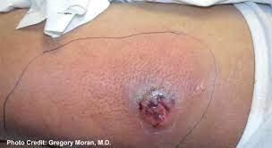
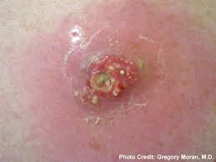
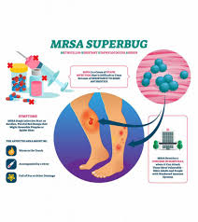
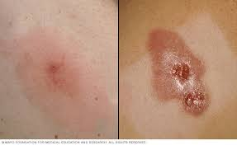

Slide 6
Who’s at risk from MRSA?
Residents with an underlying illness
Older people – particularly if they have a chronic illness
Those with open wounds or who have had major surgery
Residents with invasive devises such as urinary catheters

Slide 7

Routes of transmission
Direct spread via hands of staff or residents
Equipment that has not been appropriately decontaminated
Environmental contamination (Staphylococci that spread into the environment may survive for long periods in dust)
This Photo by Unknown Author is licensed under CC BY

Slide 8
Treatment and Screening
Any treatment required will be on an individual basis. Antibiotic treatment will only be prescribed if there are clinical signs of infection. Residents who are colonised with MRSA i.e. no signs of infection, do not usually require antibiotic treatment.
Screening is not usually undertaken in care homes but usually done in hospital settings.
If a positive result is diagnosed after a resident has been discharged from hospital the GP will be informed, and if appropriate will prescribe suppression treatment.
Screening swabs following suppression treatment are not required for residents in the community.

Slide 9
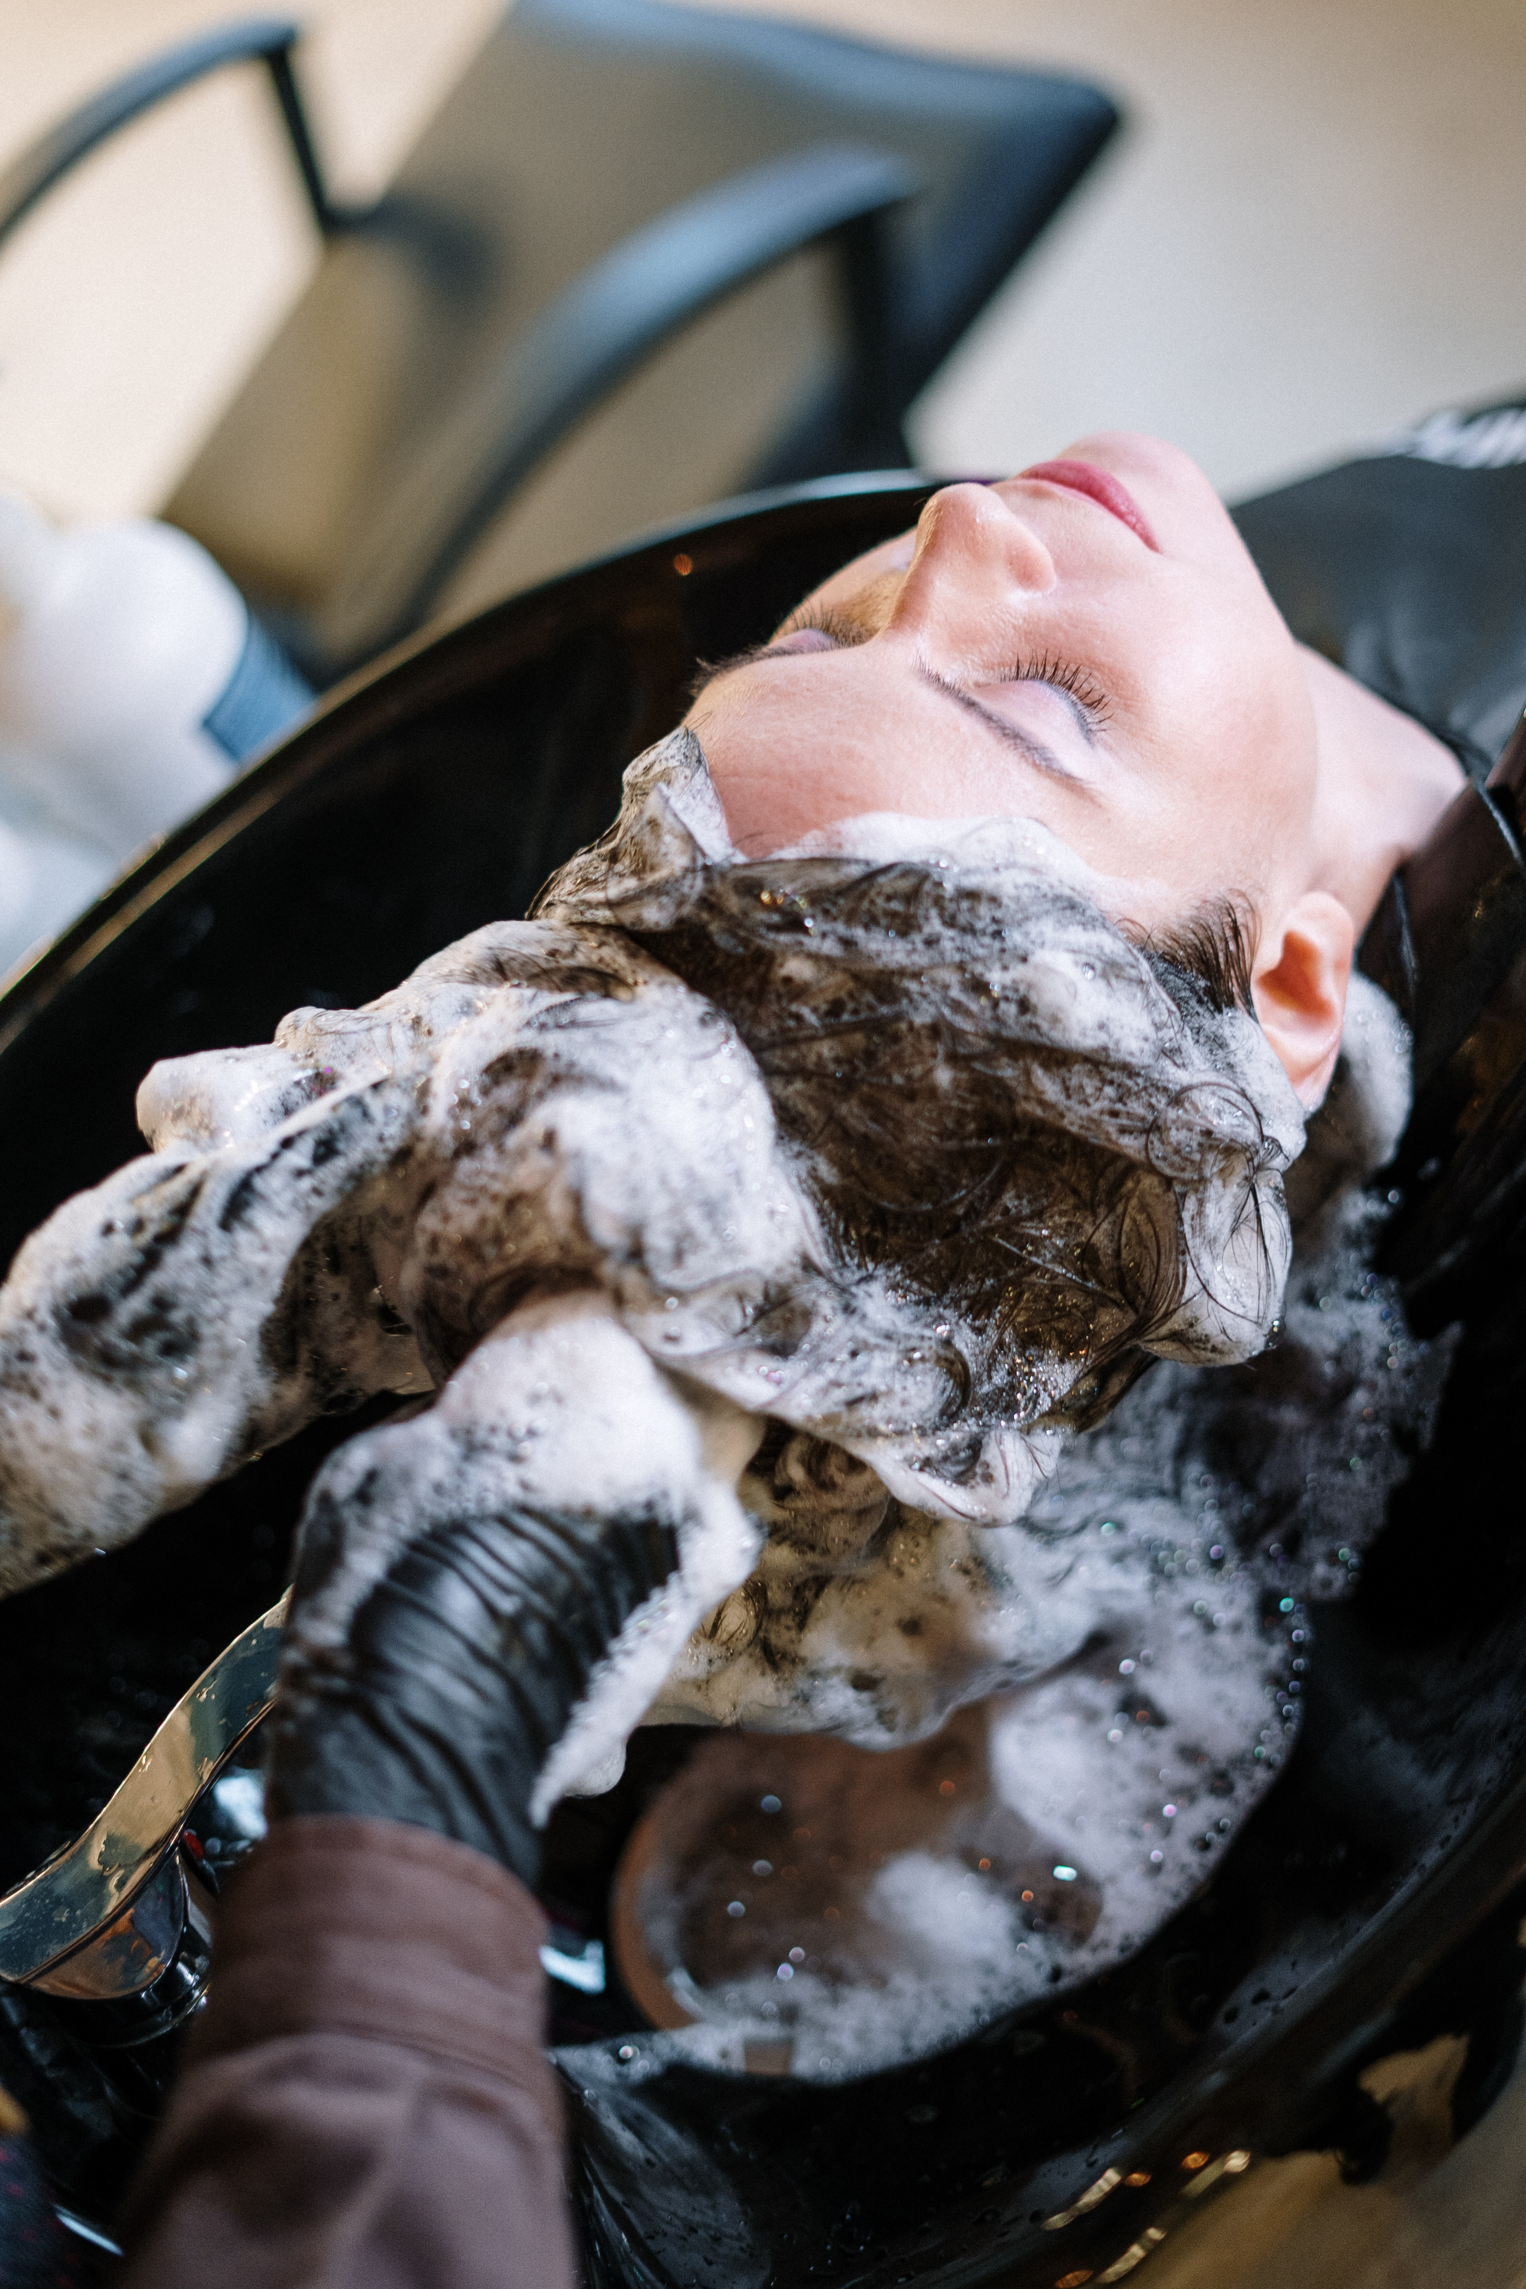
Suppression Treatment
Body and Hair Treatment
An antibacterial solution for body and hair treatment, Octanisan is used for five days. Hair needs to be washed in the solution twice through the week. The solution needs to be applied directly onto the skin and not watered down prior to going on the skin.
Nasal Treatment
Nasal Mupirocin 2% ointment or Bactroban should be used three times a day for 5 days.
For residents who have a resistance to Mupirocin, Naseptin nasal ointment should be used 4 times a day for 10 days .
Skin, hair and nasal treatments should be commenced on the same day.

Slide 10
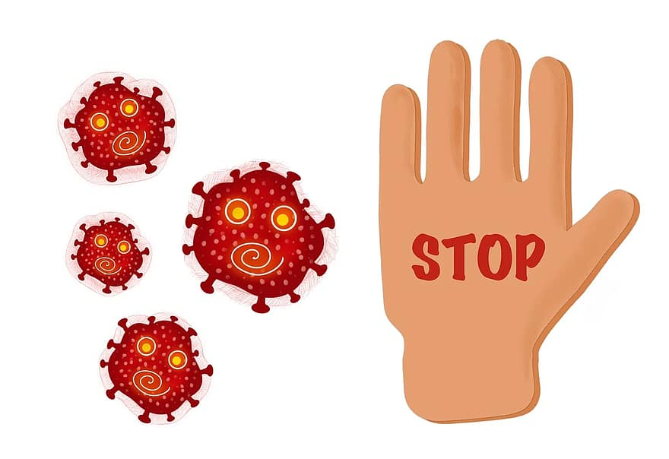
Precautions
Residents with an MRSA Infection
Residents with an active infection should be isolated until they are symptom free.
Any infected wound or skin lesion should be covered with a dry occlusive dressing or as directed by the GP or community nurse. The dressing should be checked frequently for signs of leakage and replaced accordingly until the wound is dry.

Slide 11
Precautions
Residents colonised with MRSA
It may be long term, therefore good hand hygiene and standard precautions is needed by all staff at all times to reduce transmission of infection.
A resident with colonised MRSA in their urine who is not catheterised and is continent of urine with no symptoms of a UTI is unlikely to present a risk
Residents can share a room unless any of the occupants have invasive devises or wounds etc.
Residents can visit communal areas and mix with other residents
Hand Hygiene is essential either with soap and water or alcohol gel after contact with the resident
Residents should be encouraged to wash hands prior to eating meals and after using the bathroom
Cont………..

Slide 12
Precautions
Disposable gloves and aprons should be worn when in contact with bodily fluids
Normal laundry procedures are adequate. However is sheets are soiled with urine or faeces, please treat them as infected
Staff should ensure if the resident has any wounds they are covered with a dressing
No special requirements are required for crockery / cutlery and they should be dealt with in the normal manner
Waste contaminated with bodily fluids should be disposed of as infectious waste
There is no need to restrict visitors, but they should be advised to wash hands or use alcohol gel on arrival and before leaving
Residents should not be prevented from visiting day centres etc and can socialise outside of there home
If a resident requires hospital admission , the receiving department hospital staff should be made aware of the MRSA status

Slide 13
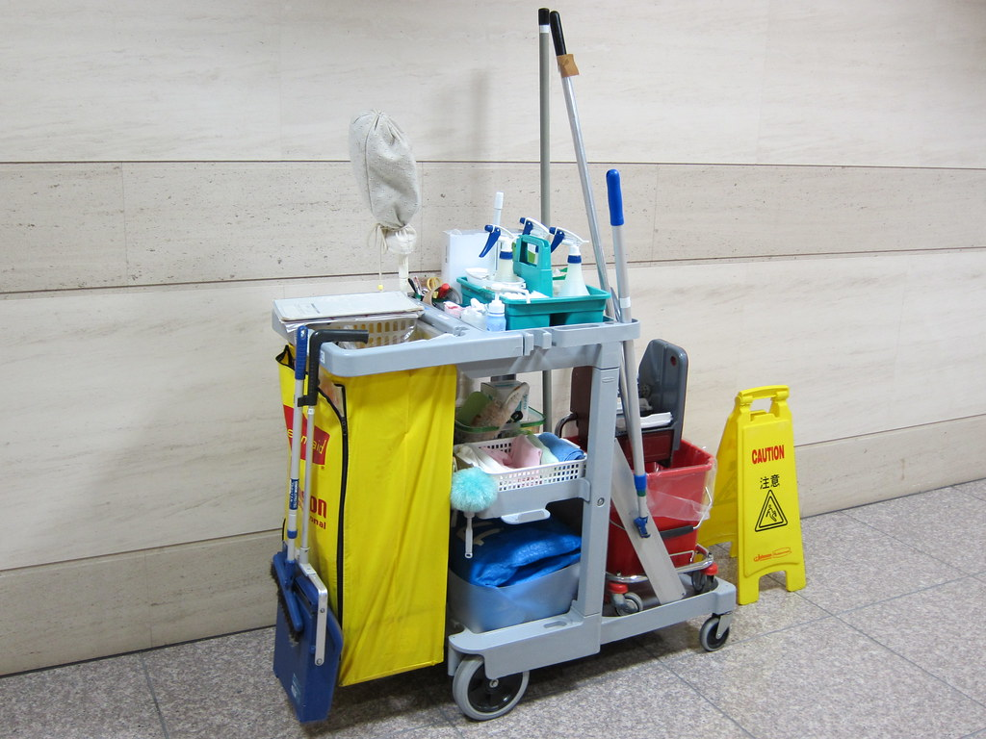
Environmental Cleaning
If a resident is isolated due to an MRSA active infection, enhanced cleaning of their room using a bactericidal product effective against MRSA or a chlorine based disinfectant solution should be implemented.
Residents who are colonised with MRSA, their room can be cleaned with a neutral detergent and warm water, a disinfectant is not required.
This Photo by Unknown Author is licensed under CC BY

Slide 14
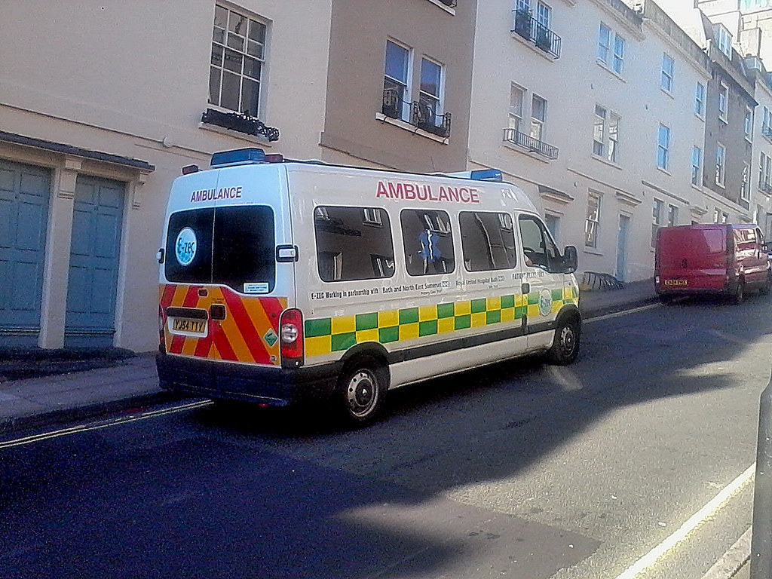
Transfer of Resident
Prior to the transfer a risk assessment needs to be completed
The admitting facility (hospital, outpatients and GP surgery etc) need to be aware of the infectious status
No special transport arrangements need to be made
This Photo by Unknown Author is licensed under CC BY-SA-NC

Slide 15
References
Department of Health (2015)The Health and Social Care Act 2008: Code of Practice on the prevention and control of infections and related guidance
https://www.infectionpreventioncontrol.co.uk/resources/mrsa-policy-for-care-home-settings/
https://pubmed.ncbi.nlm.nih.gov/9108892/
https://www.cdc.gov/mrsa/community/index.html
https://www.gov.uk/government/collections/staphylococcus-aureus-guidance-data-and-analysis
https://cks.nice.org.uk/topics/mrsa-in-primary-care/

